Slide 1


Git KIP ASSIGNMENT
AND
Git COMMIT
Presented By : DEEPAK KUMAR

Slide 2
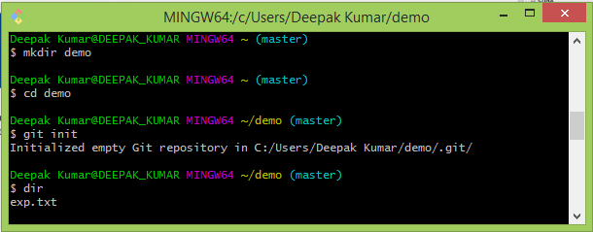
Creating a local repository
Git init : This command is used to create an empty Git repository or reinitialize an existing one. This command also creates a .git file which git uses to track all the changes. Deleting this will erase everything.

Slide 3
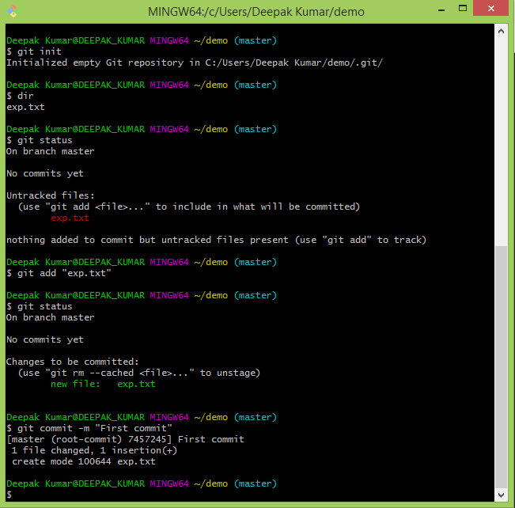
Commit a file
Git commit
This command is used to commit a file which has been staged using git add command so as to track the changes that will be further made to the file.
A sample text file GitAsg.txt is considered in the provided snapshot to be commited.

Slide 4
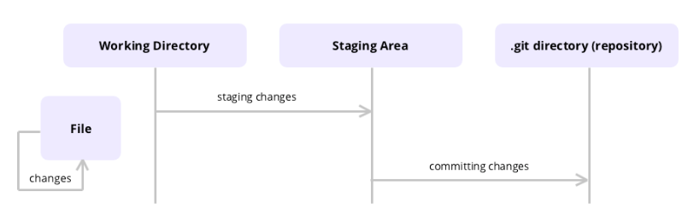
Git Commit Command
In Git, commit is the term used for saving changes.
Git does not add changes to a commit automatically. You need to indicate which file and changes need to be saved before running the Git commit command.
The commit command does not save changes in remote servers, only in the local repository of Git.

Slide 5
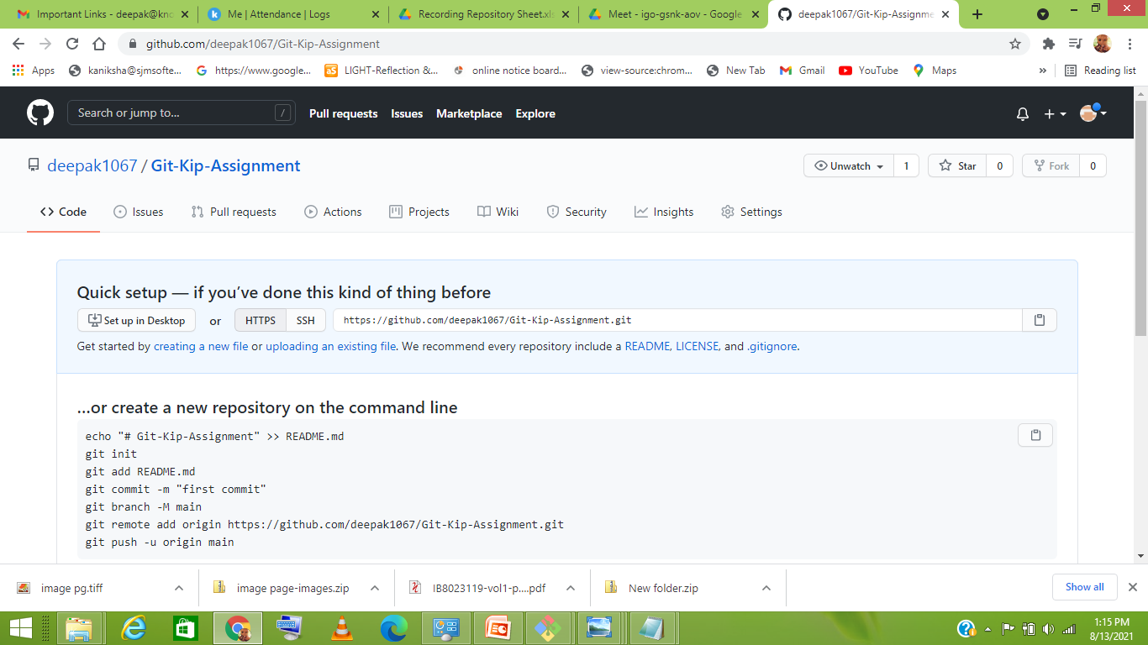
Creating a remote repository

Slide 6
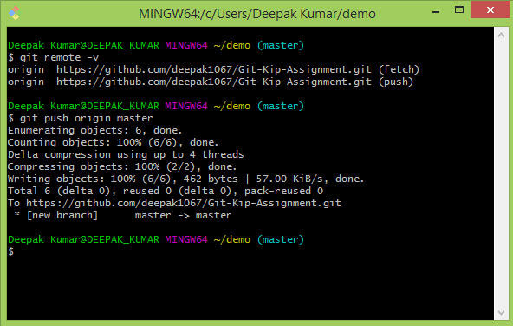
Pushing to remote repository
Git Push:
This command is used to push the specific branch and all its content to remote repository on GitHub. The command includes the branch name whose content is to be pushed along with the link to remote repository or an alias given to Remote Repository link.

Slide 7
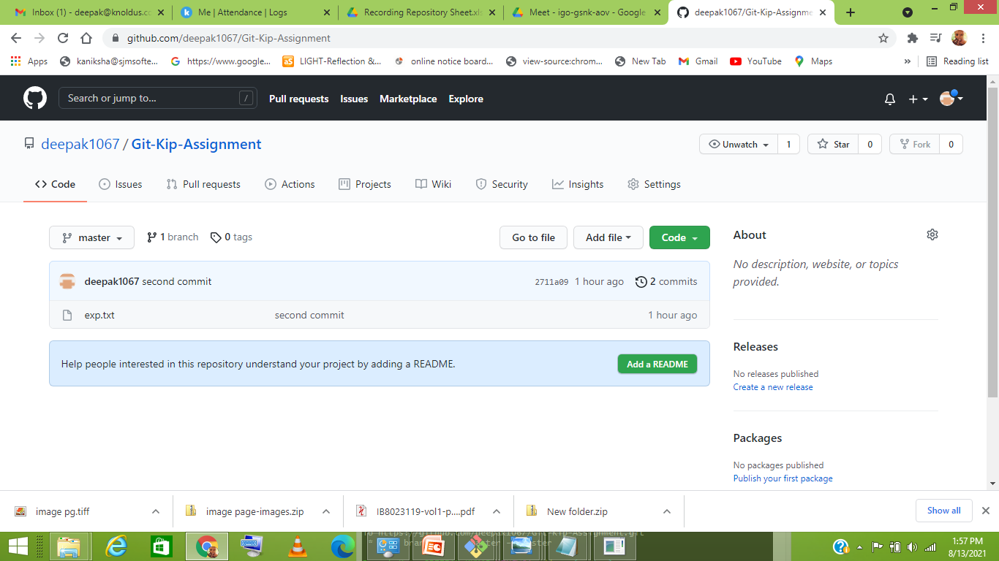
Pushing file to remote repository

Slide 8
Link for GitHub
Link for GitHub where the files were pushed:
https://github.com/deepak1067/Git-Kip-Assignment

Slide 9

Thank You!

